Slide 1
Supply Chain Management.
FINAL PROJECT
SUBMITTED TO : Manjari Maheshwari
SUBMITTED BY : SEONG KYOUNG – 0725164
: TEJAS MAHESH PATEL – 0730241
: SOORYA SURESH – 0735168
: RAJWINDER KAUR – 0732989
: YI ZHOU – 0730368
: MOHSIN MEGHJANI - 0730241

Slide 2
Retail Sales Forecasting USING MACHINE LEARNING

Slide 3
INTRODUCTION
Retail sales is basically purchase of Finished goods and services by customers and Businesses.
It is the end part of the Supply chain, The process starts with Manufacturers manufacturing the product and the Middle men such as wholesalers providing it to the Retailers and retailers selling it to the Consumers.
Every retail business must face almost the same question: how much inventory should I carry? On one hand to more inventory means working capital costs, operational costs and complex operation. On the other hand, lack of inventory leads to lost sales, unhappy customers and a damaged brand. So, choosing the appropriate method to calculate inventory, cost, which has a big benefit at customer and retailer.

Slide 4
ABOUT THE DATSET
The Dataset we have taken from Kaggle containing 4 columns from 2014 to 2016. It was extracted from a Brazilian top Retailer and data was transformed to protect the identity of the retailer.
Attributes include:
Date
Sale
Stock
Price

Slide 5
WORKS ON PYTHON
At first we imported necessary libraries and read the dataset
There are 937 rows and 4 columns
There was no null values in our dataset
Converted the column name from Spanish to English.
We started with the day of week Analysis.
By giving each day a numerical value.

Slide 6
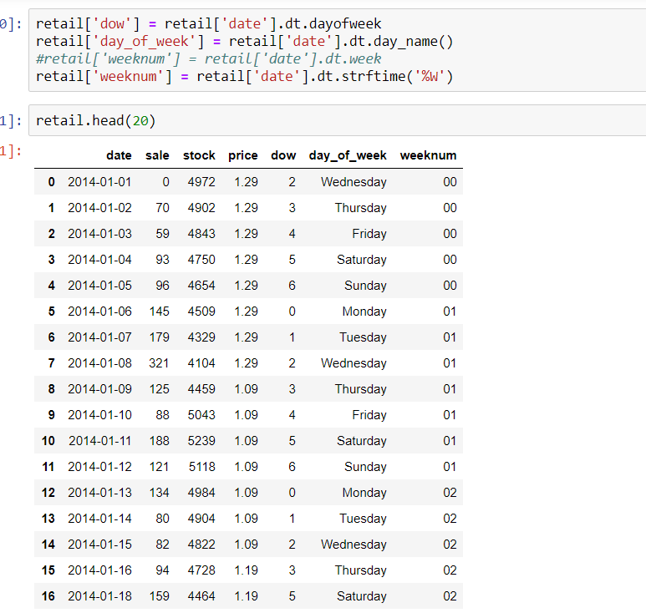
Day of week Data Analysis
We did Day of week analysis and added 3 new column are added
DOW
Day_of_Week
Weeknum.

Slide 7
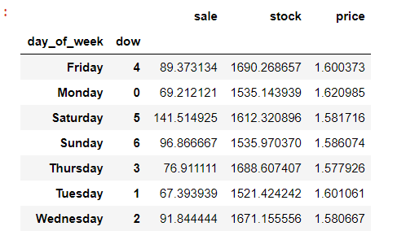
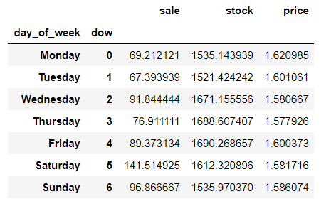
Day of week Data Analysis.
Day of week analysis
Assigning Monday = 0, Tuesday = 1, Wednesday = 2, Thursday = 3, Friday = 4, Saturday= 5 and Sunday = 6. and sorted it into ascending format.

Slide 8
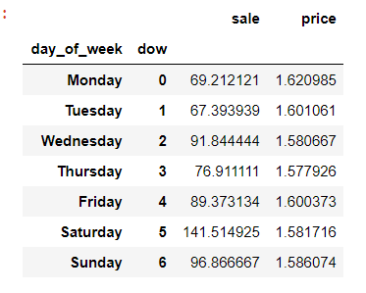
Day of week Data Analysis
We dropped the stock column and started making plots to see the relationship between Avg Price and Avg Sales.

Slide 9
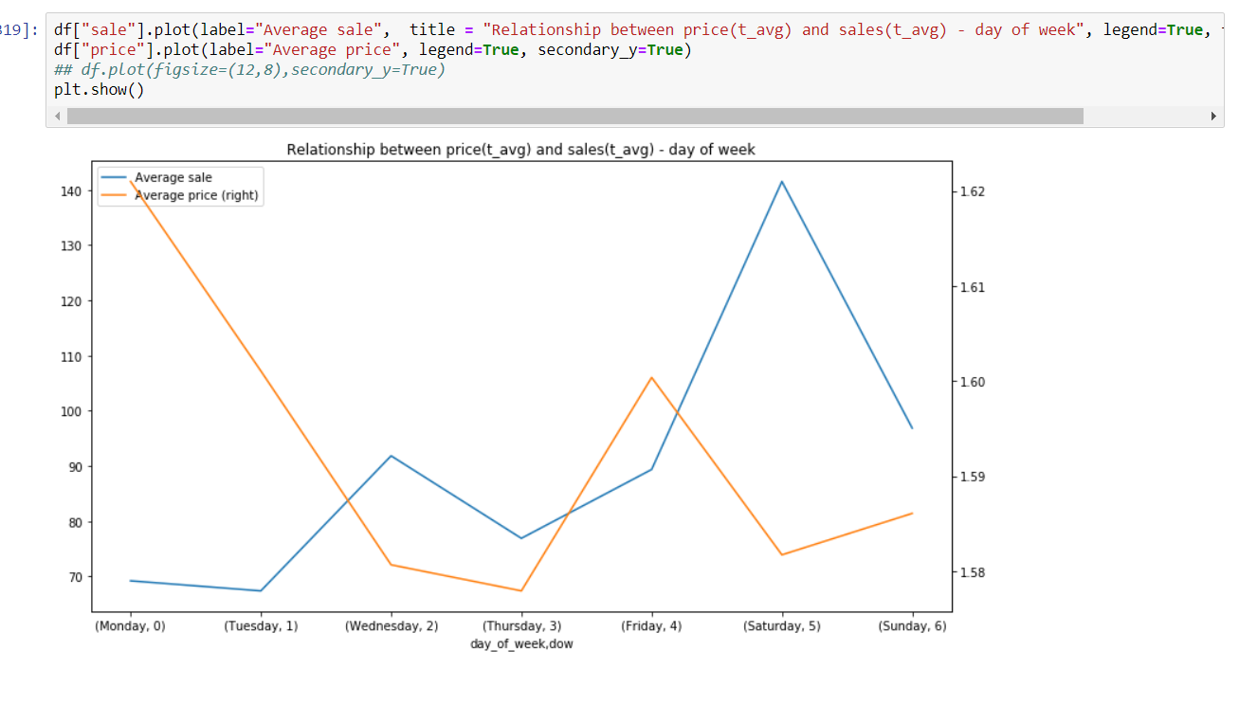
Relationship Between Sales and Price
According to dual weekly graph, we could find there is an inverse relationship between sales and price

Slide 10
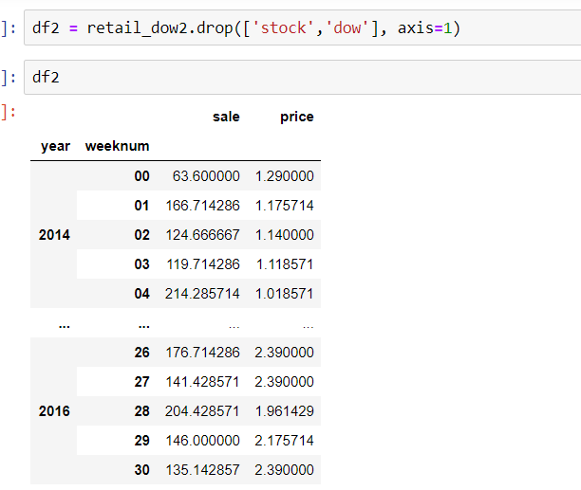
Group by
We create a new Data frame and used group by function by using year and Weeknum column
And then we dropped stock and dow column and created a new data frame as DF2

Slide 11
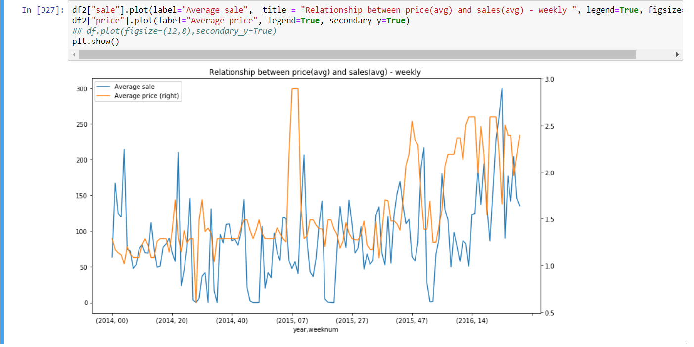
In this we created a graph to see the relation ship between Avg Price and Avg sales on a weekly basis.

Slide 12
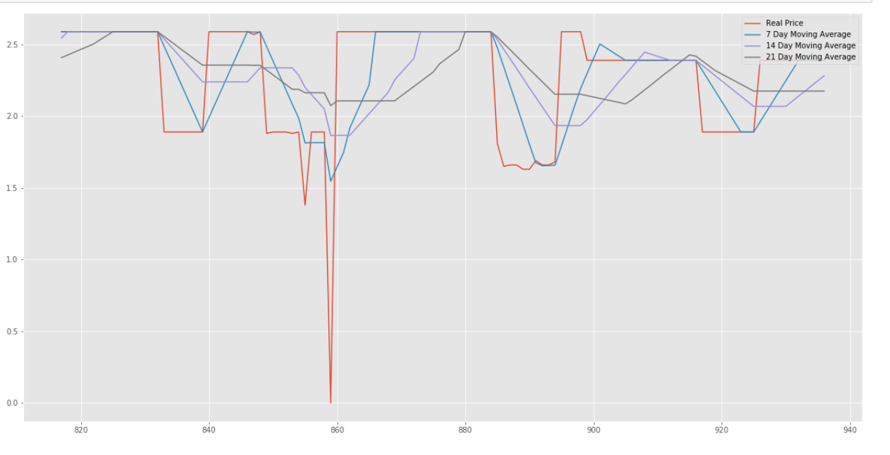
Moving Average
We did a 7, 14 and 21 day Moving Average for Price and plotted the graph with the real price.

Slide 13
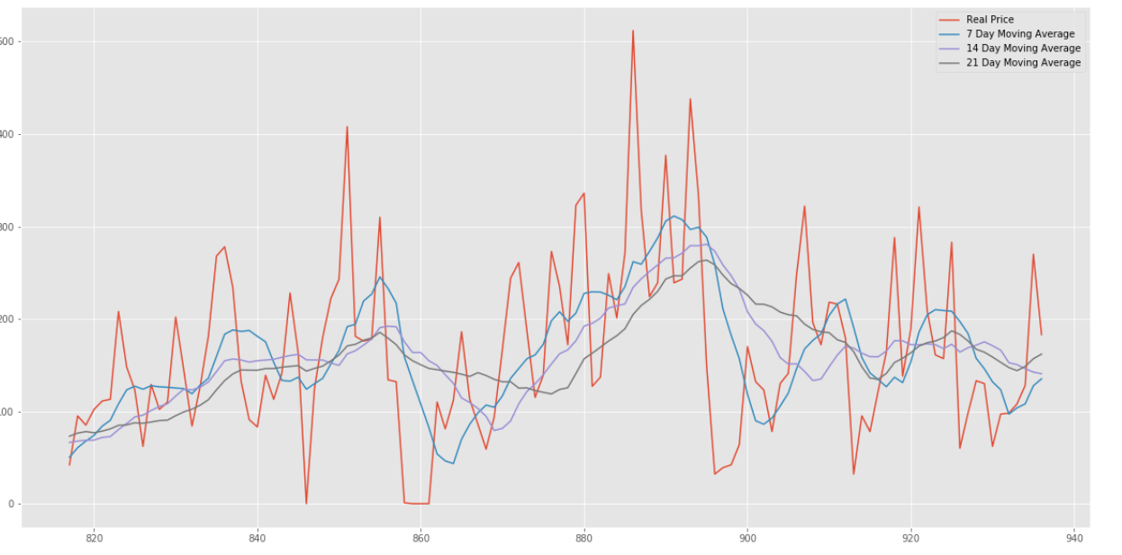
Moving Average
We did a 7, 14 and 21 day Moving Average for Price and plotted the graph with sale.

Slide 14
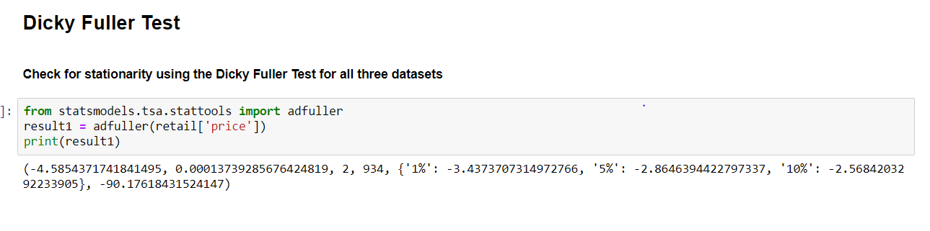
Dicky Fuller Test
We did a Dicky Fuller test for the datasets for checking if it is stationery or not.
dicky fuller test result is -4.5 less than -3.4 at 1%.
Therefore this is stationary dataset.

Slide 15
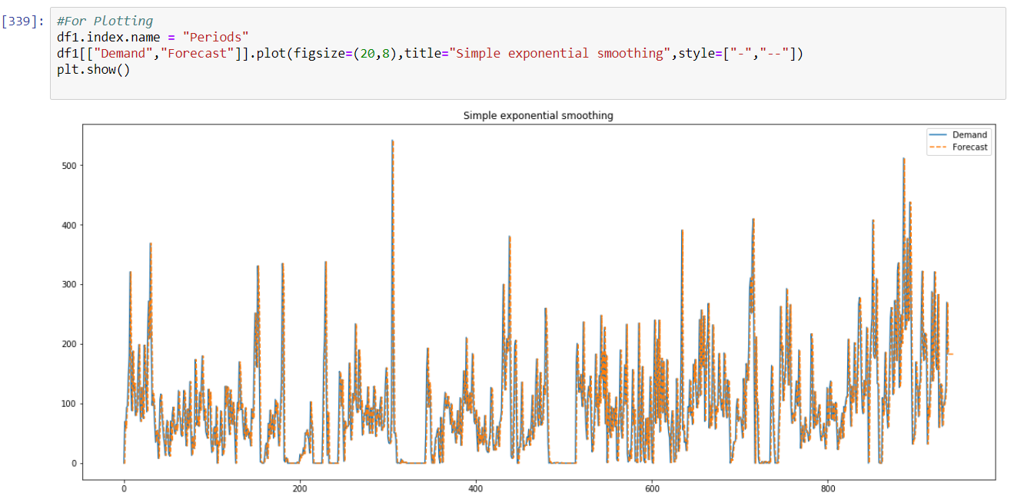
SIMPLE EXPONENTIAL SMOOTHING
We started with the Simple Exponential Smoothing and calculated the KPI(MAE AND RMSE)
We got the MAE Value as 45.01 and RMSE value as 67.76.
W then Plotted the Demand and forecast for SES

Slide 16
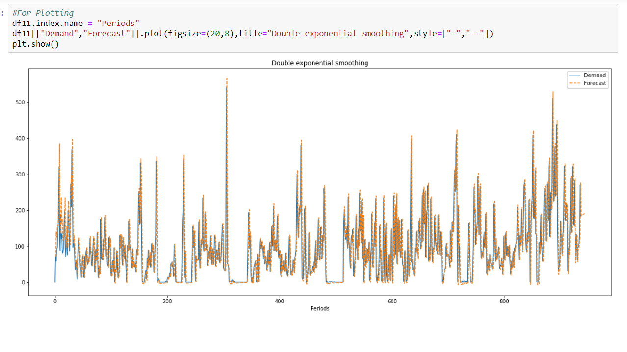
DOUBLE EXPONENTIAL SMOOTHING
We did Double Exponential smoothing to find the level an trend and calculated KPI
We got MAE value as 46.76 and RMSE value as 69.77
We plotted demand and forecast for DES

Slide 17
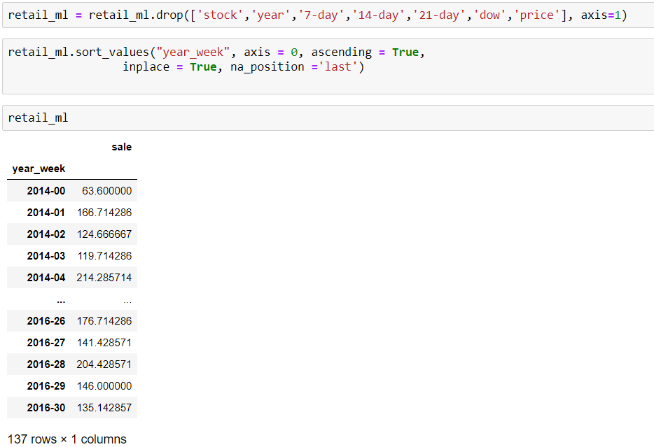
Machine Learning Models
We have added year_Week Column
We have group by it using year_Week
After Group by e have dropped stock,year,7-day,14-day,21-day,dow and Price Columns.

Slide 18
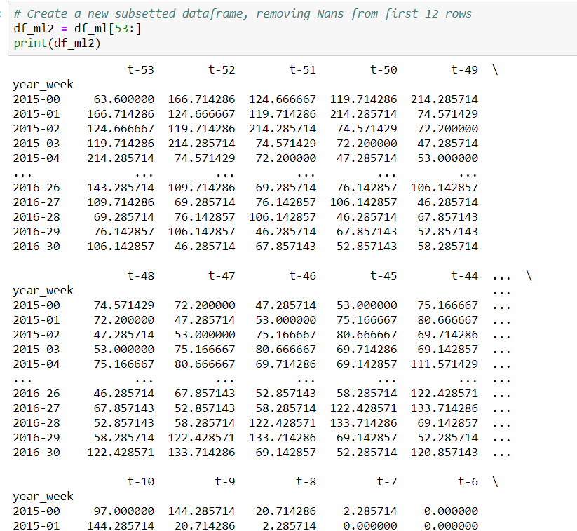
Machine Learning Models
We have divided the whole year into 53 weeks
After that we have dropped the sale column.
After that we have subset of data frame and Removed the Nan values.

Slide 19
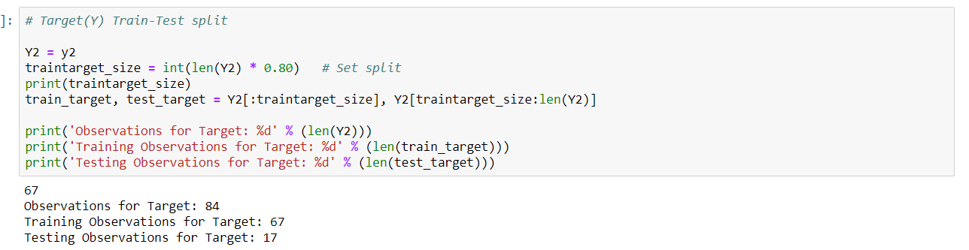
Machine Learning Models
We have splitted the data into Dependent and Independent Variable.
We have used 80-20 and 70-30 split for the Models
We have created Linear regression, Decision Tree model and Random Forest Model

Slide 20
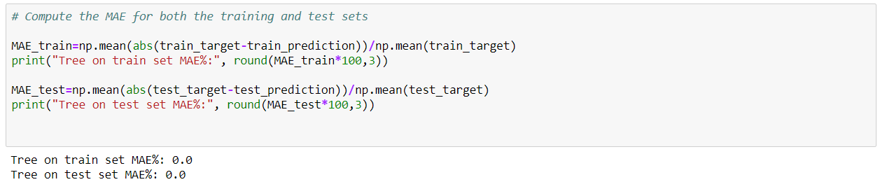
Machine learning model with 80-20 split Linear Regression Model
We have created a linear egression model and as you can see the MAE is 0.0
The data is overfitting the model.
The test score is negative value, so that we cannot use this model.

Slide 21
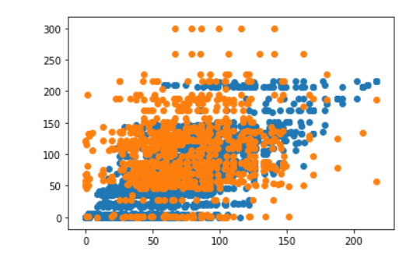
Decision Trees Model
We have created a decision tree Model and find the best max depth
Which is 10 and with MAE of train at 29.9 and MAE of test at 50.8
The test score is negative value, so that we cannot use this model.

Slide 22
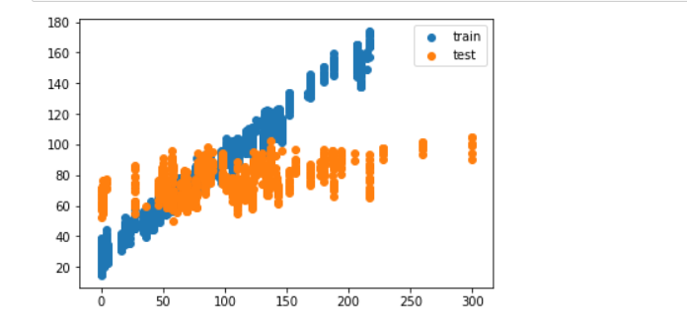
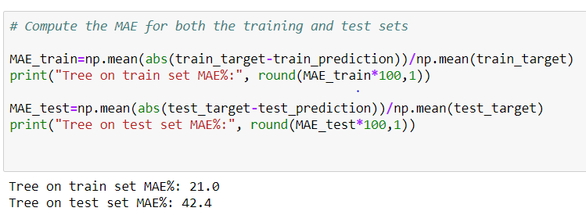
Random Forest
We have created random forest model with max_depth of 10
MAE of train at 21
MAE of test at 42.4
The test score is negative value, so that we cannot use this model.

Slide 23
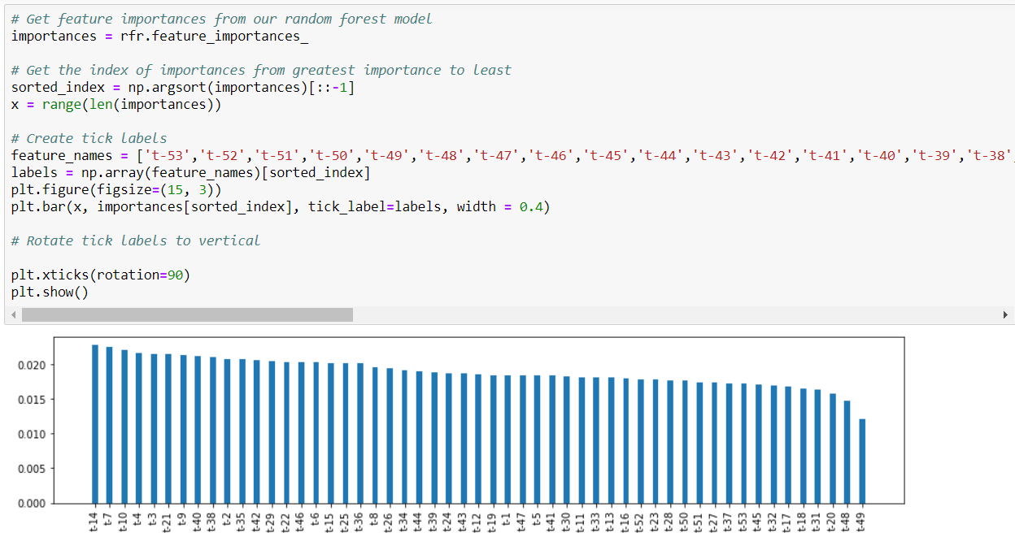
Random Forest Model
This is the Feature Importance of the Random Forest Model
As we can see that t-14 is the most important and t-49 is the least Important feature in our dataset.

Slide 24
Machine learning Model with 70-30 split Linear Regression
Now we have done the Same Machine learning Model with 70-30 Split.
As we can see the Linear Regression Model is Overfitting the data
As the MAE value for Train and test are 0
The test score is negative value, so that we cannot use this model.

Slide 25
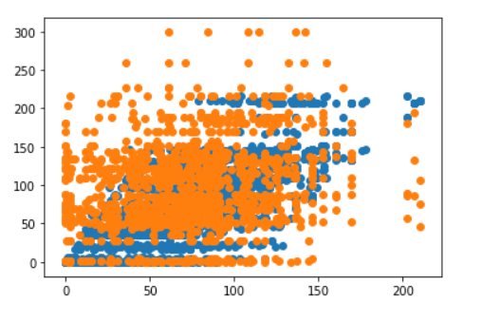
Decision Trees
We have Done Decision Trees with 70-30 split
MAE of Train is 27.7
MAE of test is 53.9
The test score is negative value, so that we cannot use this model.

Slide 26
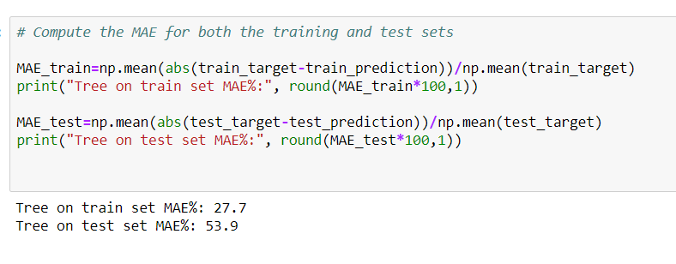
Random Forest
We have done Random Forest with 70-30 split.
MAE of Train is 27.7
MAE of test is 53.9
The test score is negative value, so that we cannot use this model.

Slide 27
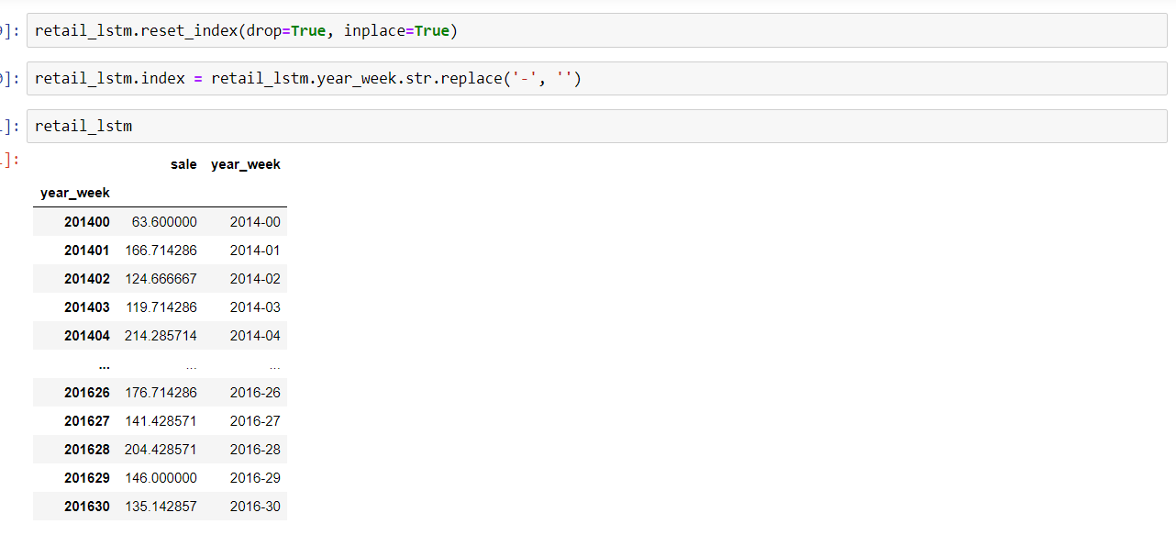
Long Short term Memory.
We Created an LSTM Model with year_week and sale and we replaced the ‘-’ with no space
As we had the year_week column twice so we dropped the second column.

Slide 28
Long Short term Memory.
Next step was to divide the data set into train and test.
We have used min max scaler to scale the data.
We have used min max scaler as it will get values between 0 and 1

Slide 29
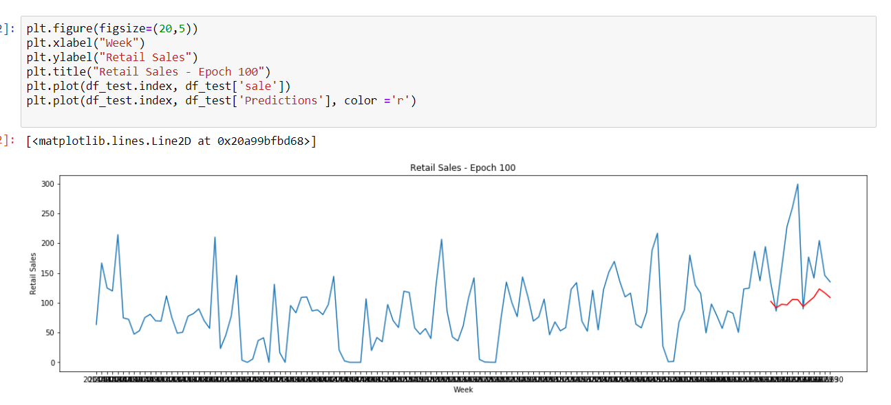
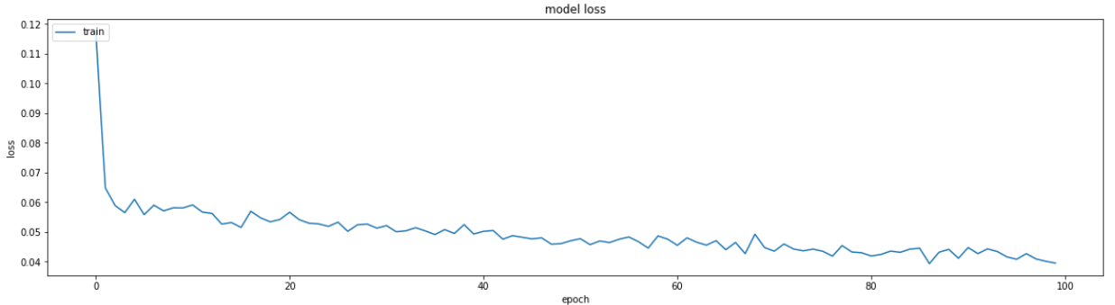
Long Short term Memory at Epoch 100
We started with using Epoch 100
As you can see we have plotted the Retail sales graph of 100 epoch from 2014 to 2016 on an weekly basis.
Below is the plot of Model loss for epoch 100.
RMSE Value is 87.82.

Slide 30
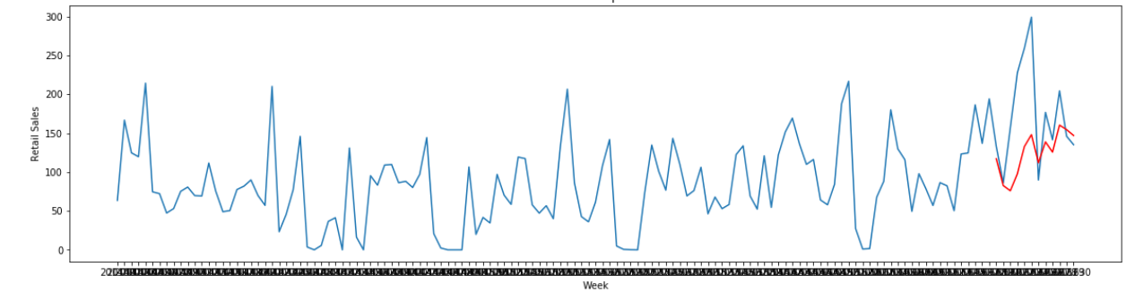
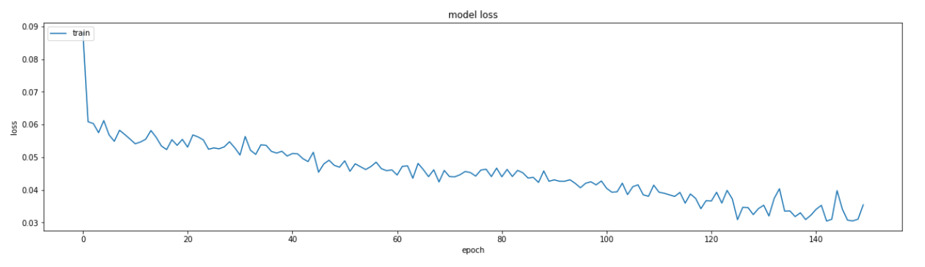
Long Short term Memory at Epoch 150
We have increased the epoch size to 150 and we can see the prediction is getting better.
we have plotted a retail sales graph for 150 epoch on a weekly basis
Below is the Model loss for the 150 epoch.
RMSE Value is 100.25.

Slide 31
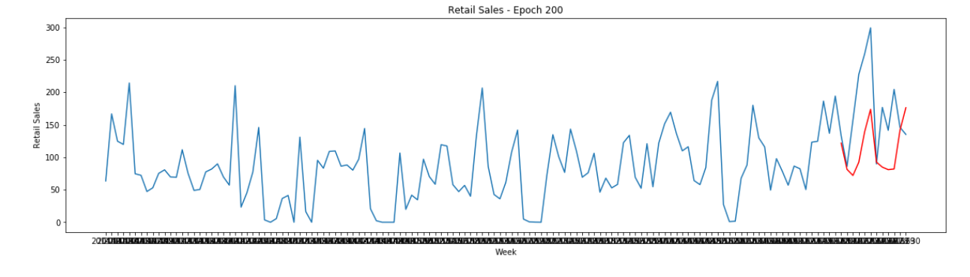
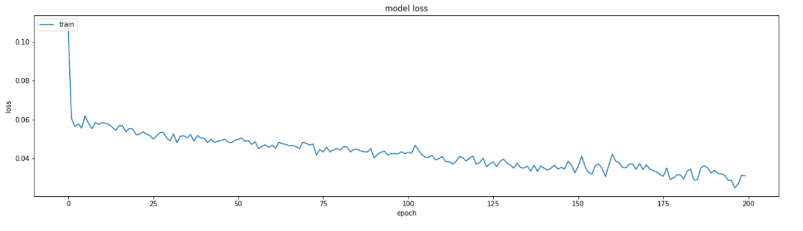
Long Short term Memory at Epoch 200
We have increased the epoch size to 200 and we can see the prediction is even better compared to 100 and 150.
we have plotted a retail sales graph for 200 epoch on a weekly basis
Below is the Model loss for the 200 epoch.
RMSE Value is 86.06

Slide 32
Comparison Table .
Model | RMSE
SES | 67.76
DES | 69.77
LSTM at 100 epoch | 87.82
LSTM at 150 Epoch | 100.25
LSTM at 200 Epoch | 86.06

Slide 33
Conclusion .
According to our dataset SES model is the best model when compared to the other Model.
As SES model has the lowest RMSE Value.
Although we have created all possible model for prediction of sale, the simple exponential smoothing is the best way which has the minimum RMSE.

